Slide 1
Mendel and Heredity
Ms. Mercado
10th grade Biology

Slide 2
Objective
After reading this presentation, students will explain that Mendel’s research showed that traits are inherited as discrete units.

Slide 3
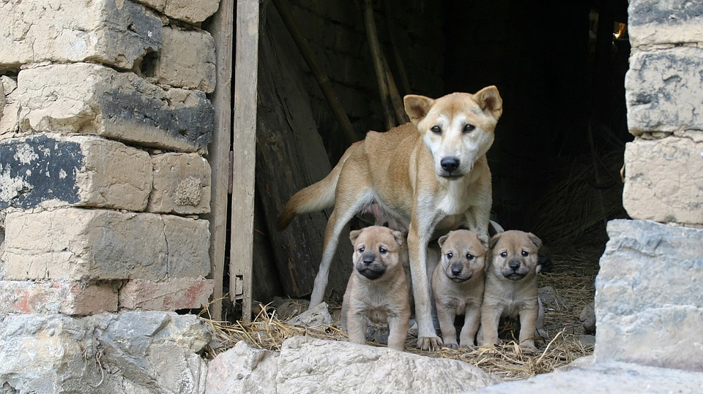
Mendel laid the groundwork for genetics
How does offspring resemble or differ from their parents?
It’s all about traits!

Slide 4
Mendel laid the groundwork for genetics
Traits are distinguishing characteristics that are inherited, such as eye color, leaf shape, and tail lenght.
Genetics is the study of biological inheritance patterns and variations in organisms.
Did you complete your genetic characteristics inventory?
https://quizizz.com/admin/quiz/5e8a4726c64ee7001b359e40?studentShare=true

Slide 5
Mendel laid the groundwork for genetics
Groundwork of genetics was established in 1800’s
Gregor Mendel
Austrian monk and mathematician
Bred thousands of plants
Predicted the results of meiosis before chromosomes were discovered
Recognized that traits are inherited as discrete units from the parental generation
Recognized that organisms inherit two copies of each discrete unit, now called genes
Described how traits are passed between generations.

Slide 6
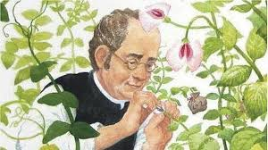
Mendel laid the groundwork for genetics

Slide 7
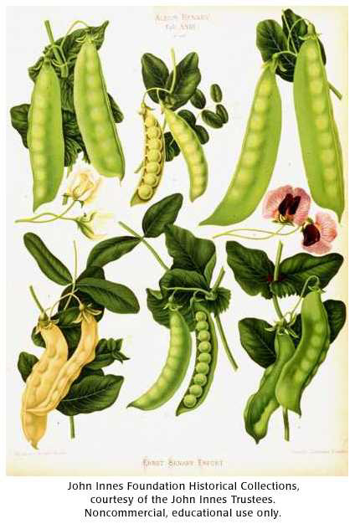
Mendel’s data revealed patterns of inheritance
Mendel studied plant variation in a monastery garden
He made three key choices about his experiments
Control over breeding
Use of purebred plants (genetically uniform)
Observation of “either-or” traits that appeared in only two alternate forms
This Photo by Unknown Author is licensed under CC BY-NC-ND

Slide 8
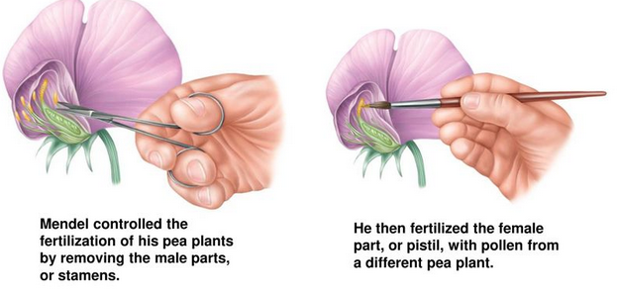
Mendel’s data revealed patterns of inheritance
Mendel chose pea plants for his experiments because they reproduce quickly and he could easily control how they mate (interrupting self-pollination)
Because he started with purebred plants, he knew that any variations in offspring resulted from his experiments.

Slide 9
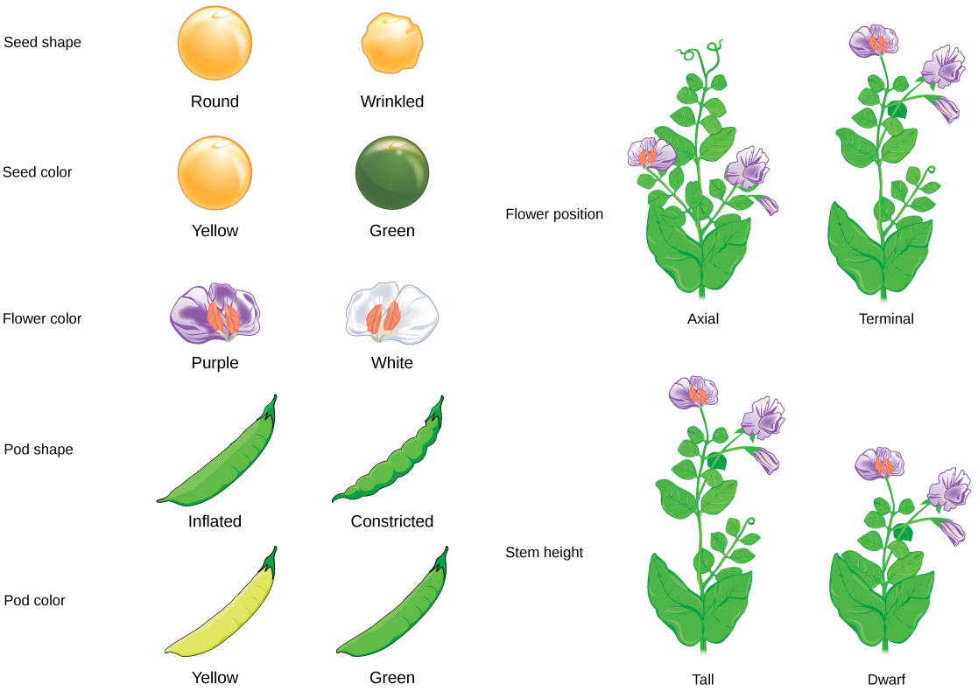
Mendel’s data revealed patterns of inheritance
Mendel chose seven traits to follow:
Pea shape
Pea color
Pod shape
Pod color
Plant height
Flower color
Flower position
These didn’t show intermediate features.
He didn’t know the genes that controlled these characteristics were on separate chromosomes.
This Photo by Unknown Author is licensed under CC BY-SA-NC

Slide 10
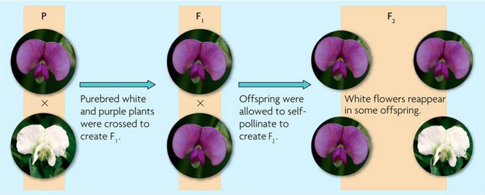
Mendel’s data revealed patterns of inheritance
Cross: mating of two organisms
Parental generation (P), First filial generation (F1), Second filial generation (F2)

Slide 11
Mendel’s data revealed patterns of inheritance
Results
He crossed one purple flower with a white flower (P)
The result was an offspring with purple flowers (F1)
He allowed the F1 generation to self-fertilize
The F2 generation produced both purple and white flowers
The trait for white flowers had not disappeared; it had been hidden or masked.

Slide 14
Formative Assessment
Copy and answer in your notebook
Send a picture to your teacher via email nmercsoto@gmail.com

Slide 15
Quizziz
Answer the following quiz https://quizizz.com/join?gc=262635
The quiz is worth 15 points! Remember to write your full name when answering in Quizziz.

Slide 16
References
Nowicki, S., & Holt McDougal. (2012). Holt McDougal biology. Orlando, Florida: Holt McDougal.

